Slide 1
Public Libraries - Adelaide

Slide 2
You wouldn’t read about it
Delivering the city’s library infrastructure model
Marian Morgan-Bindon
Manager Library Services and Cultural Development City of Gold Coast
We surf the Gold Coast waves without wiping out… And yes our poodles are pink
3 libraries 3 weeks 3 stories

Slide 3
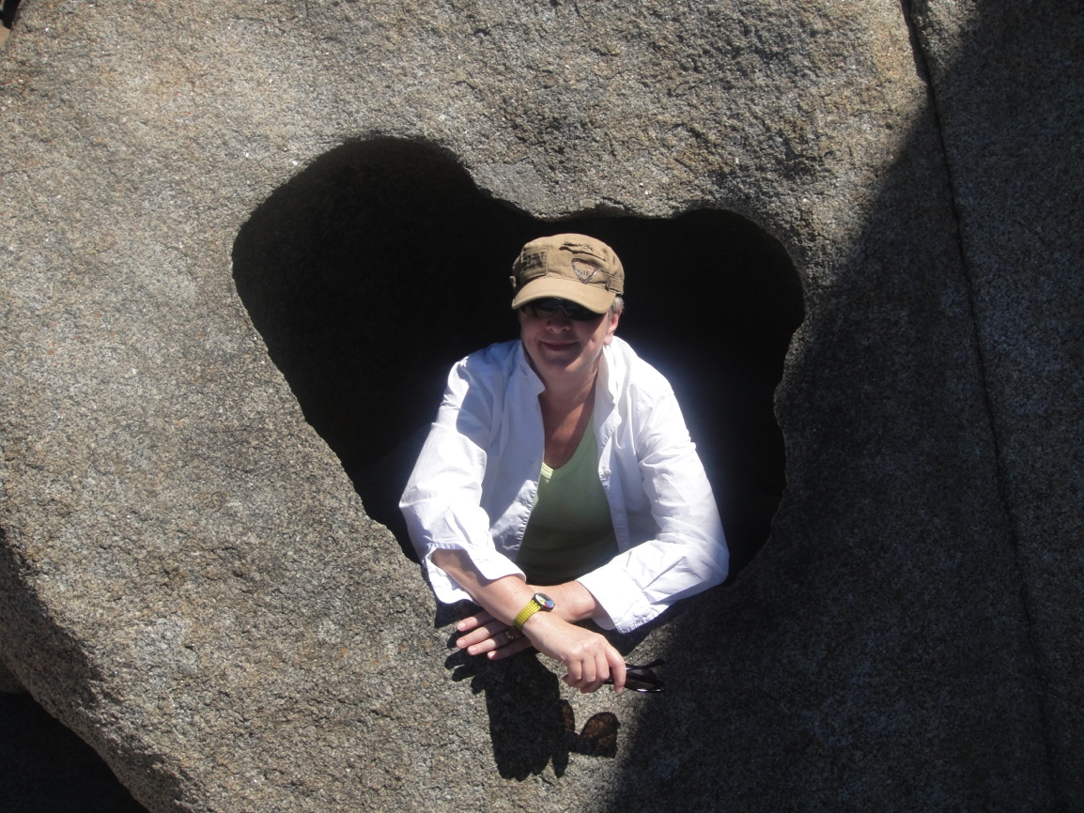
Thank you
Notes:
I love south australia

Slide 4
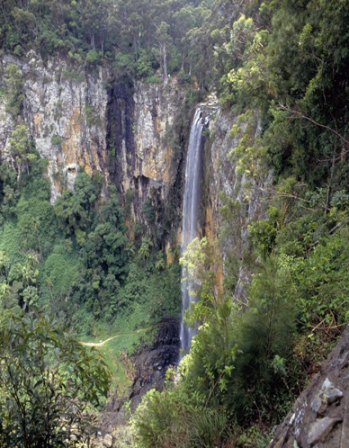
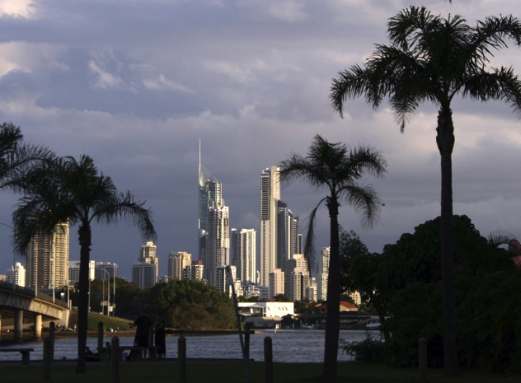
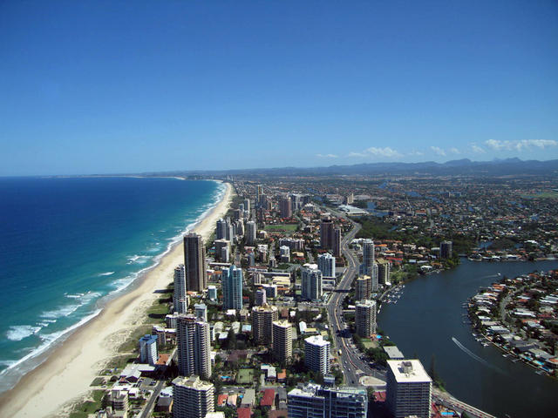
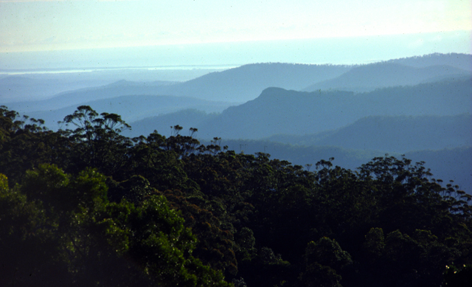
Book your next holiday here!
Image courtesy of Gold Coast info
http://www.goldcoastinfo.net
Notes:
City of contrasts

Slide 5
The City of Gold Coast
510,671 residents
70 km beaches
260 km navigable waterways
287 days sunshine (usually)
2,245 parks
Almost 9,000 visits to the city’s libraries each day
13 Branch Libraries
One Mobile Library
Local Studies Library
Special Needs Library
Corporate Library
Collection Services
Small Admin unit

Slide 6
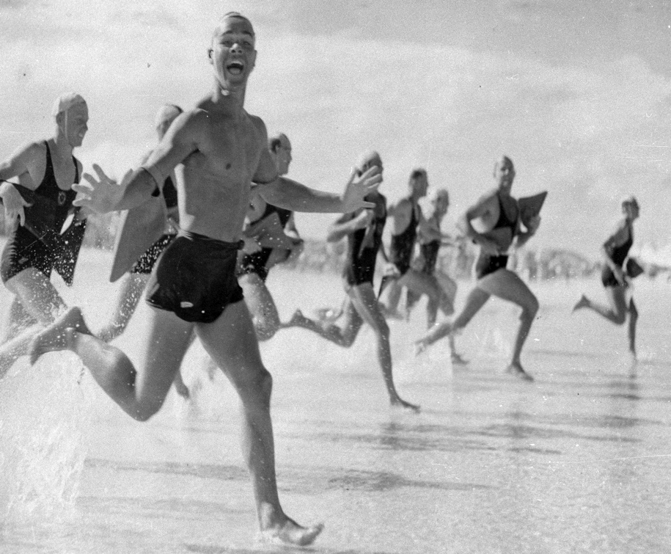
Make no mistake the Gold Coast is a creation of the late 20th Century.
It was not forged by the intellectual fervour of an international design competition, as was Canberra. It was not kicked off with an historic envisioning statement “this will be the place for a village” as was Melbourne. It has no “birth date” as does Sydney.
No. The city of the Gold Coast emerged in the latter decades of the 20th century because the Australian people willed it into existence ! Bernard Salt “The big Picture” 2006.
Notes:
We were willed into existence
Urban, suburban and rural

Slide 7
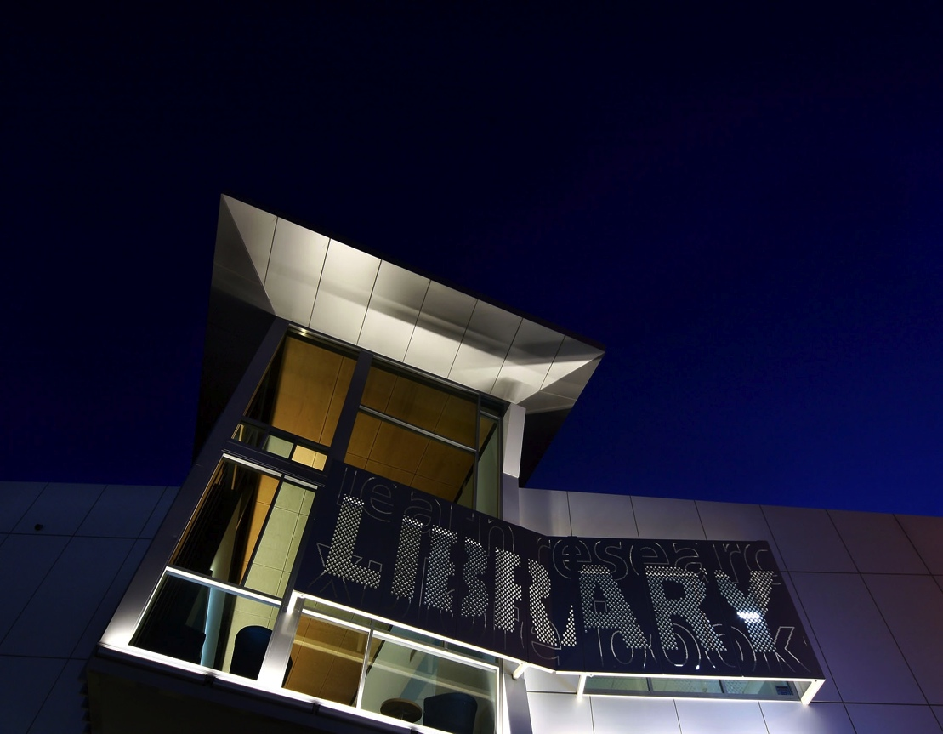
Council’s approach
The provision of a recognisable Council presence in the community that contributes to a sense of place and reaches customers at a location where they go about their everyday business
The facilities function as spaces for social and community engagement
Notes:
10 year library infrastructure and service improvement program, Gold Coast City Council has achieved on time and within budget a number of ambitious building and ICT projects
Gold Coast City Council has opened new libraries at Robina (July 2000), at Southport (2002), and at Nerang,and Mudgeeraba (2003) Elanora (2007) Broadbeach 2008 and three more in 2013.

Slide 8
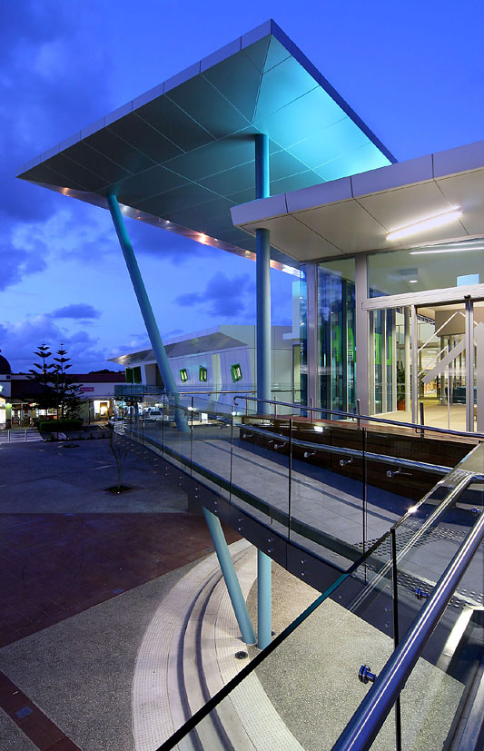
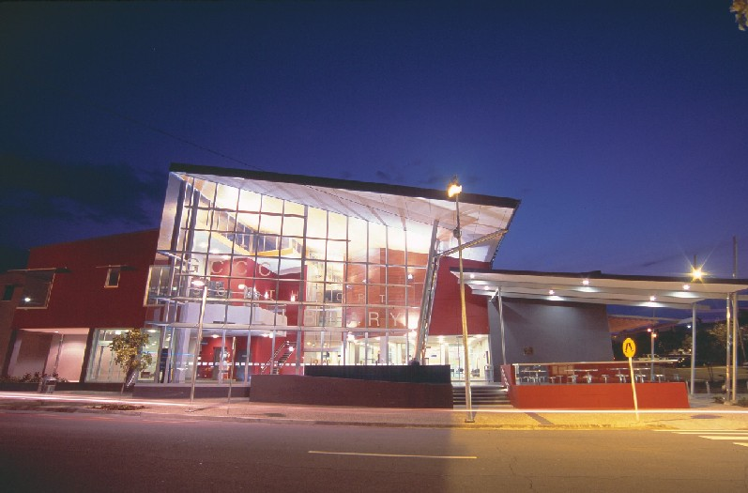
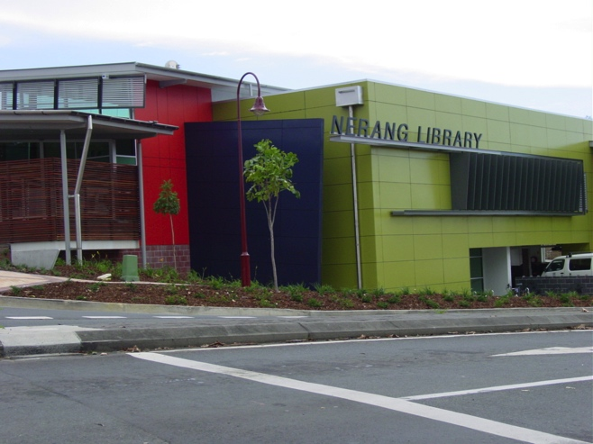
Gold Coast Libraries

Slide 9
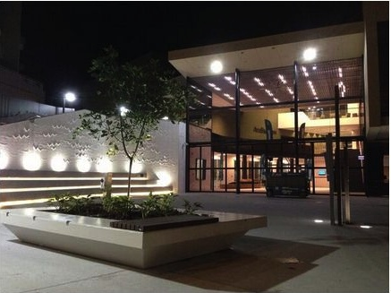
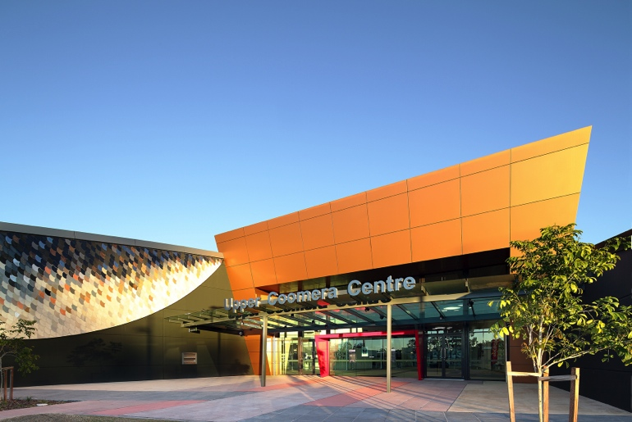
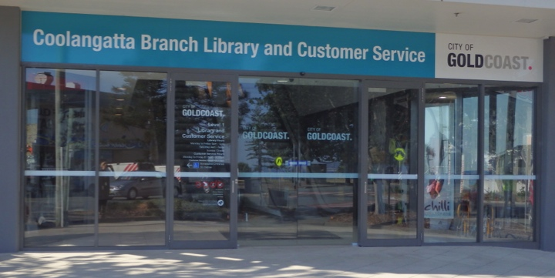
The new kids on the block

Slide 10
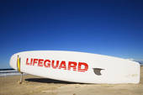
Positioning and Strength
Long term planning
Evidence base
Preparedness
-
https://gcccopac.sirsidynix.net.au/client/search/asset/1343823 lifeguard tower
Notes:
So what has our delivery to do with surfing!
Surfing can be broken into several skills:
Preferred positioning on the wave is determined by experience
Our strength is and long term planning framework
our strong evidence base

Slide 11
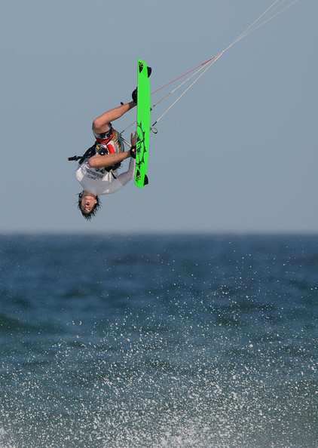
Try new things
(December 9, 20102010-12-09 16:00:00 - Source: Matt Roberts/Getty Images AsiaPac) upside down
Notes:
And a penchant for requesting our architects try new things

Slide 12
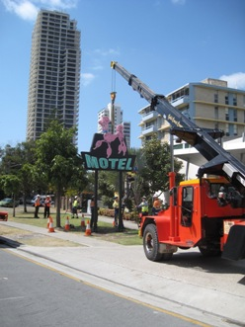
But where are the poodles you ask!
http://www.goldcoast.qld.gov.au/pink-poodle-finds-new-home--11016.html
Friday, 28 September 2012 11:45 am
Notes:
Rich post war history
BUT rich pioneering history, an indigenous culture and more than a surfers paradise Pink Poodle finds new home
Friday, 28 September 2012 11:45 AM
The Gold Coast’s beloved Pink Poodle sign has found a new home.
The heritage-listed neon sign will be reinstalled today in Fern Street, close to its original location at the Pink Poodle Motel, on the corner of the Gold Coast Highway, Surfers Paradise.
In February 2011, the sign was placed into storage at a Council depot to allow for early works for the Gold Coast Rapid Transit project. It has since been fully restored and refurbished to meet the relevant electrical standards.
Smallest of all - but though of interest

Slide 13
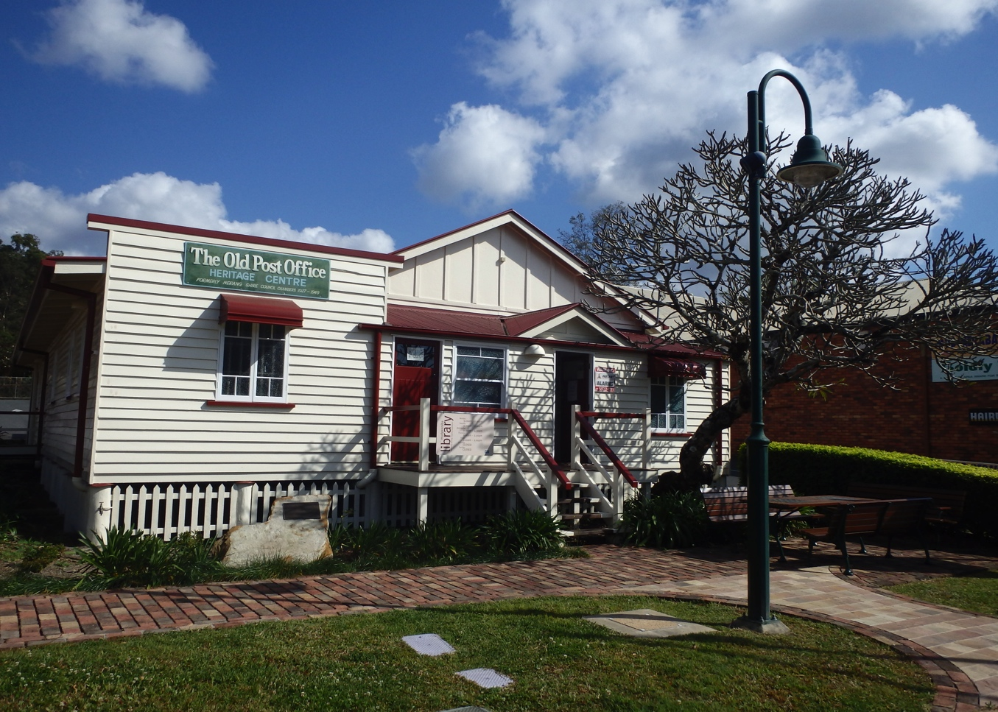
Mudgeeraba Branch Library – a level three library
-

Slide 14
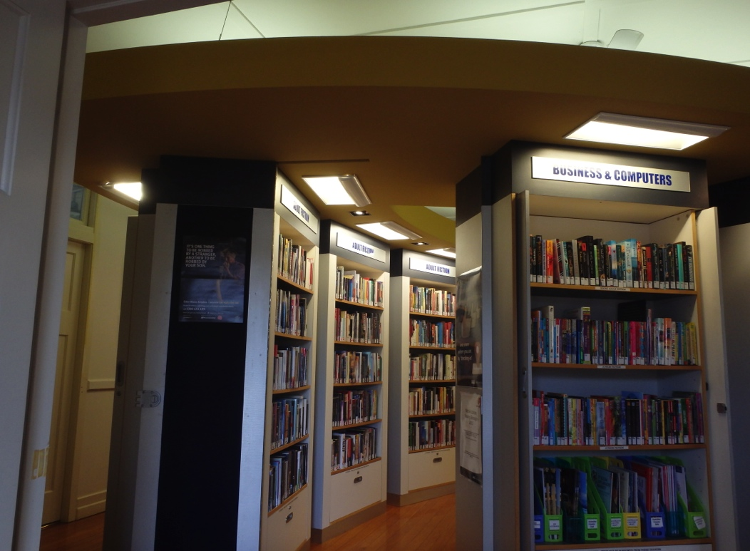
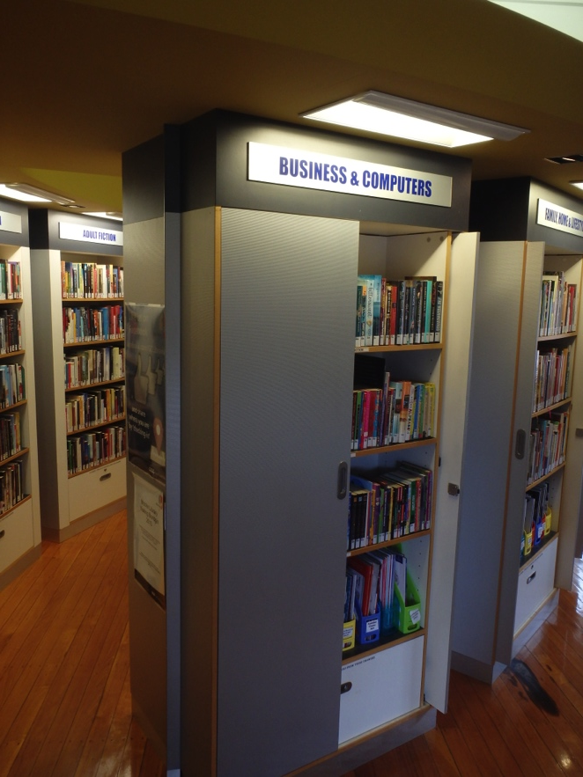
Notes:
Rich post war history
Nights at the pink poodle and at Coolangatta
BUT rich pioneering history, an indigenous culture and more than a surfers paradise
Smallest of all - but though of interest

Slide 15
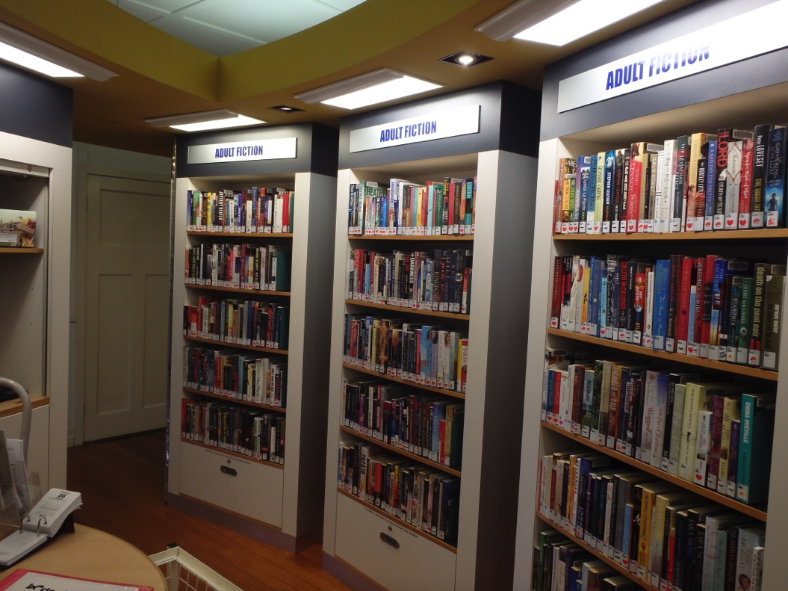
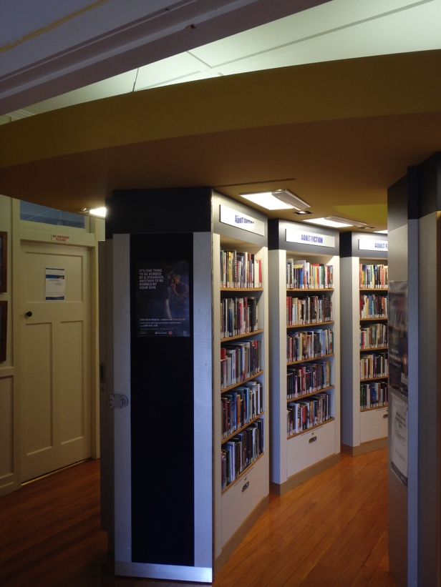
-

Slide 16
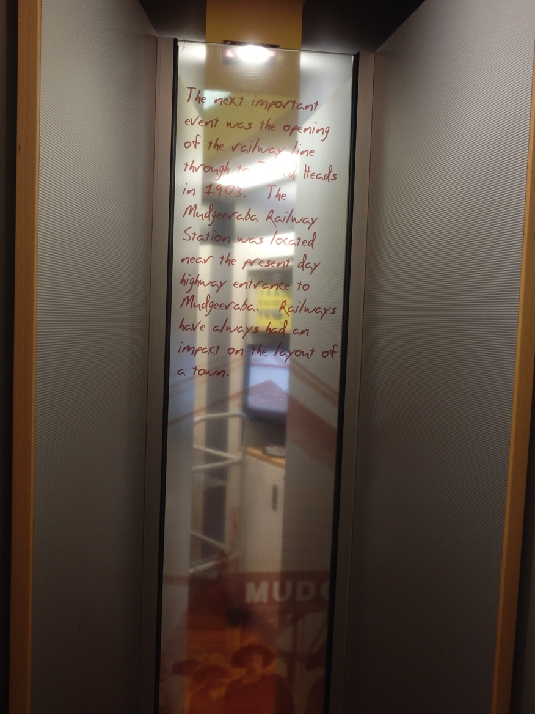
Mudgeeraba Branch Library
The most important event was the opening of the railway line through to Burleigh Heads in 1903. …Railways have always had an impact on the layout of the town.

Slide 17
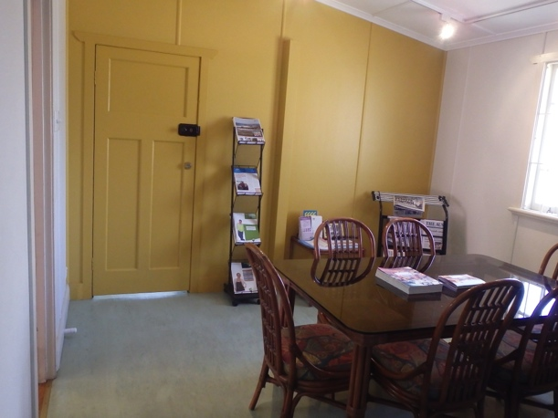
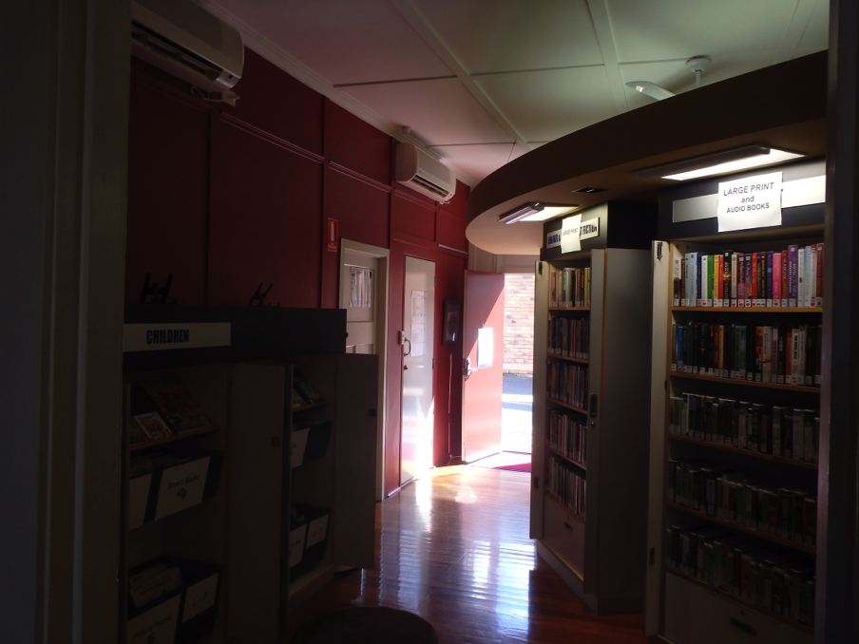
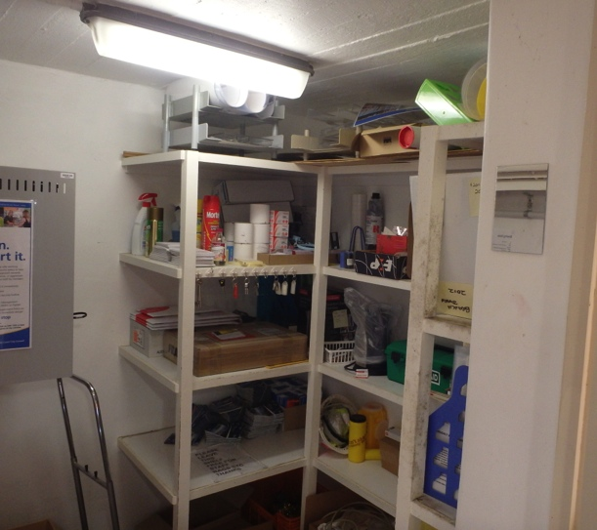
-
Notes:
Safest stationery cupboard

Slide 18
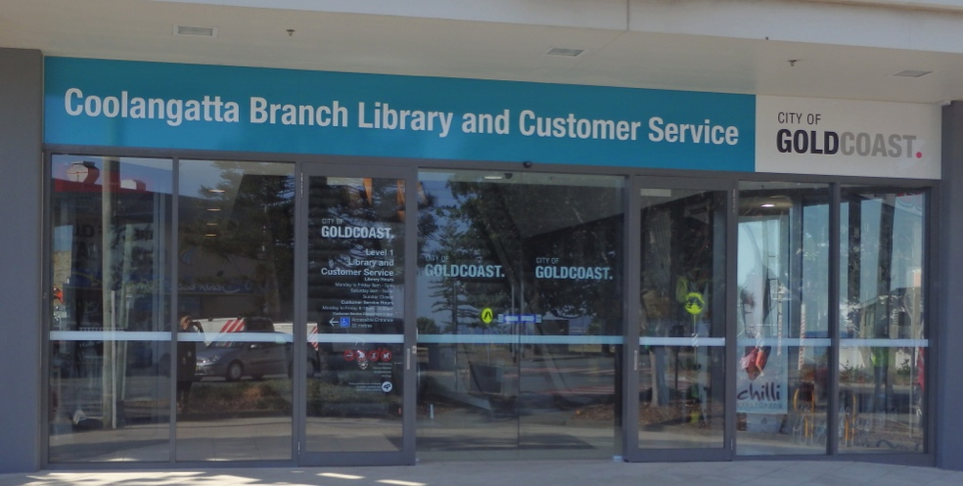
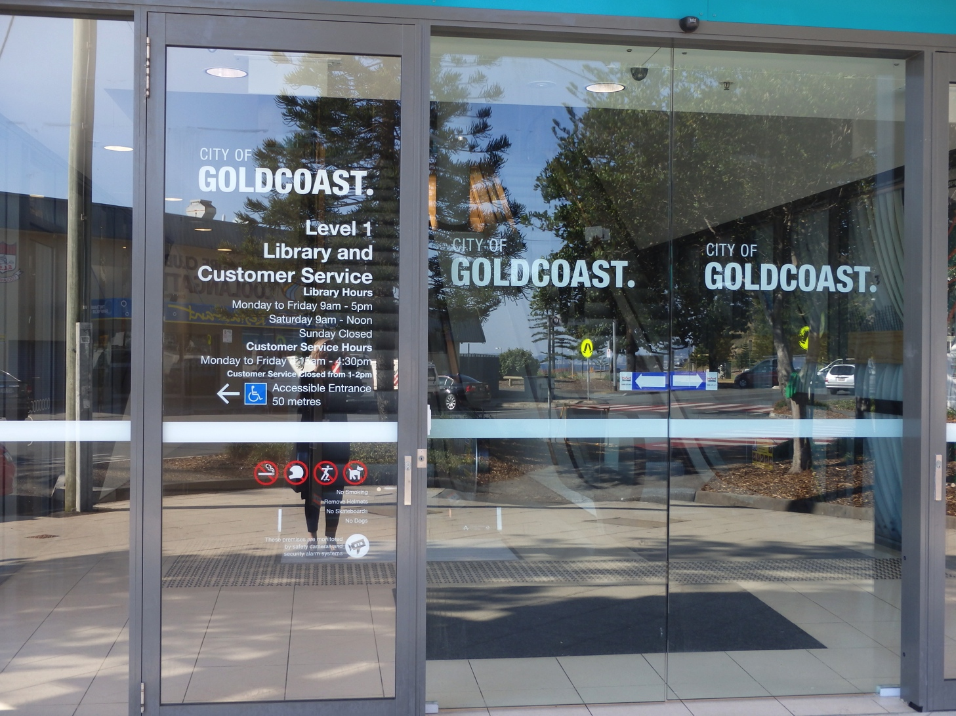
Coolangatta - a level two branch library
Opened: 29 July 2013
Architects: Henderson Hays Hamilton
Floorspace: Collection: Public access PCs: 10
Average loans per month: 12,300
Average visits per month:8,880

Slide 19
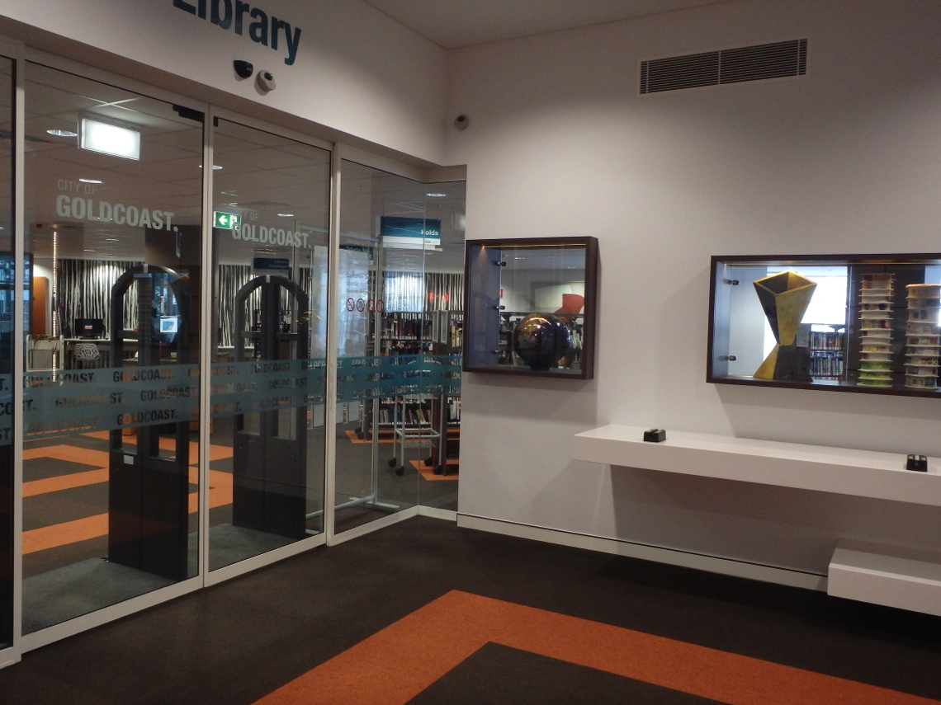
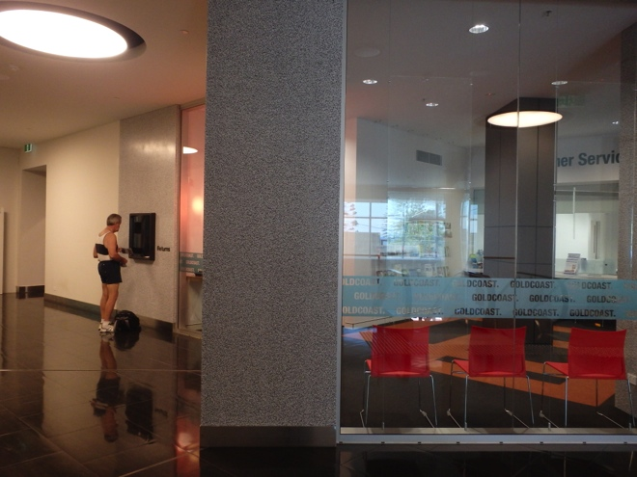
-

Slide 20
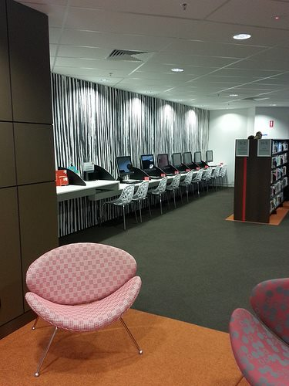
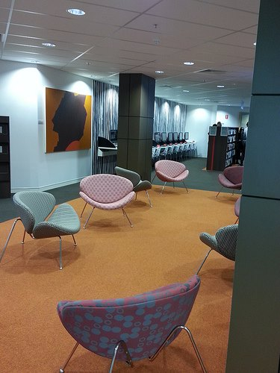
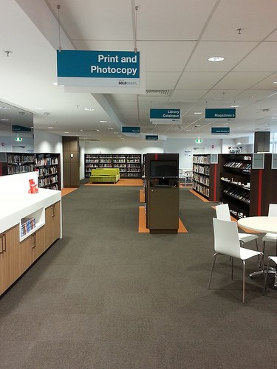
-

Slide 21
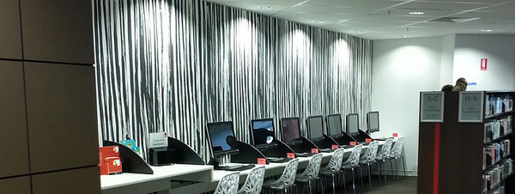
-

Slide 22
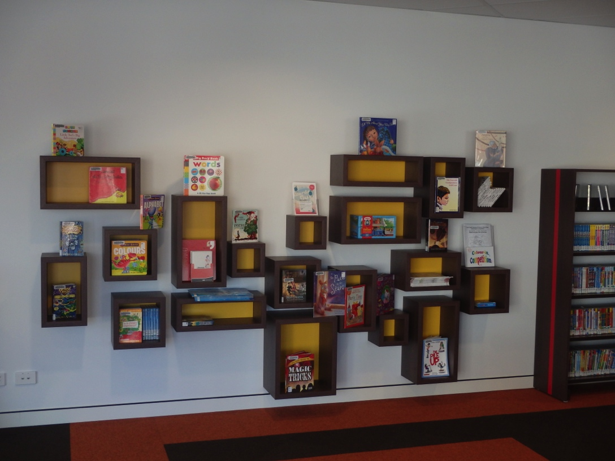
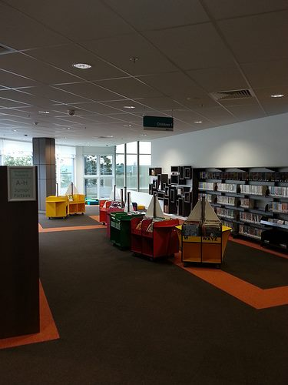
-

Slide 23
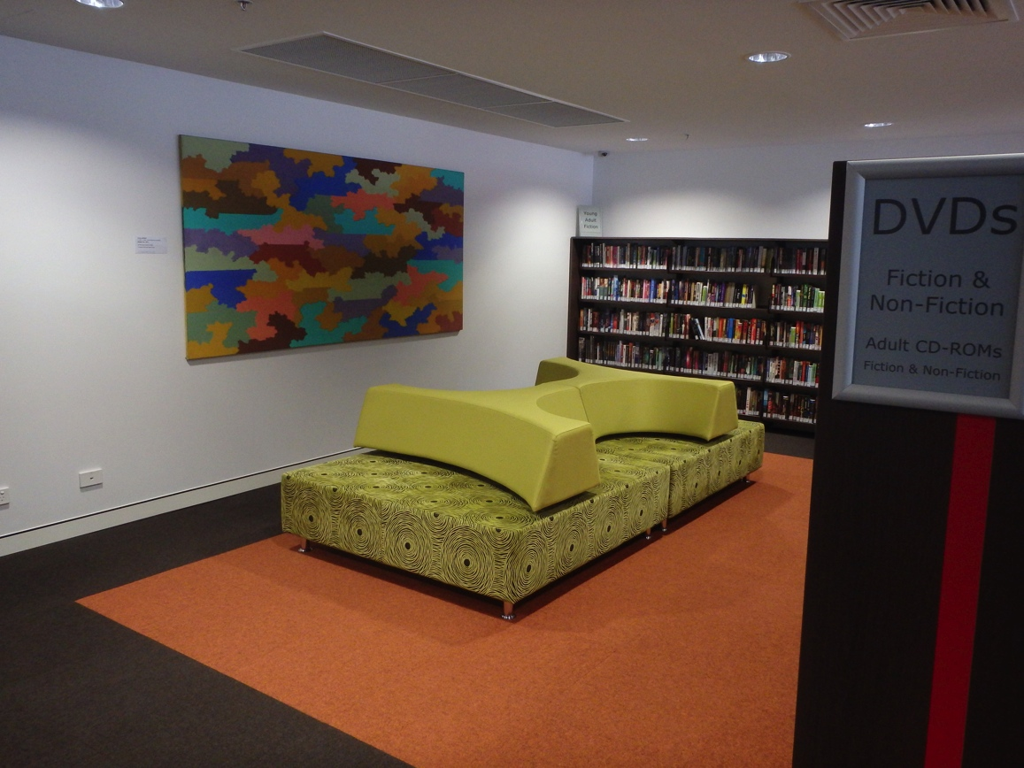
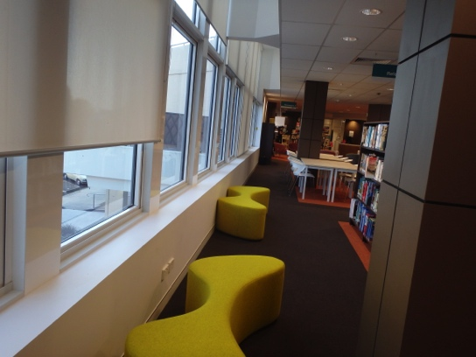

Slide 24
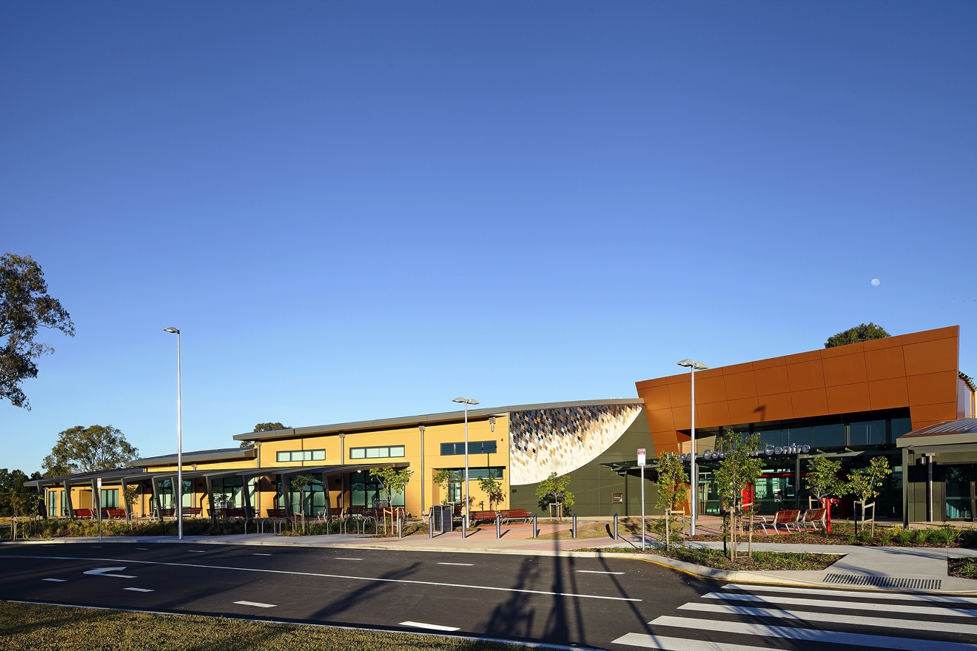
Upper Coomera Branch Library – a level two local level library
Opened: 14 June 2013
Architects: Interiors :Daryl Jackson Pty Ltd Floorspace: Collection: 35,000
Public access PCs: Average loans per month:
Average visits per month: 27,000

Slide 25
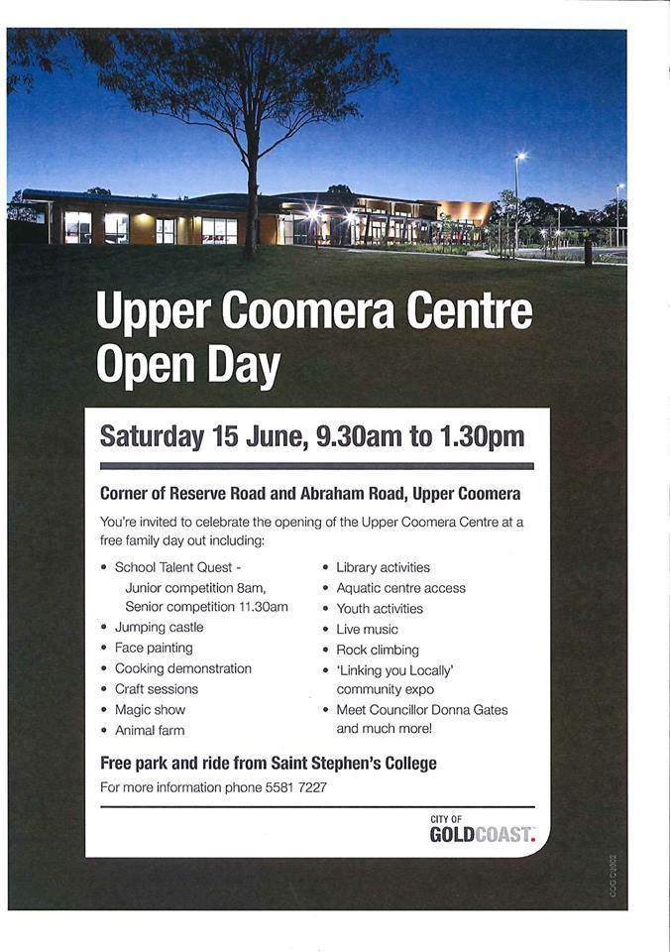
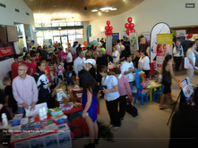

Slide 26
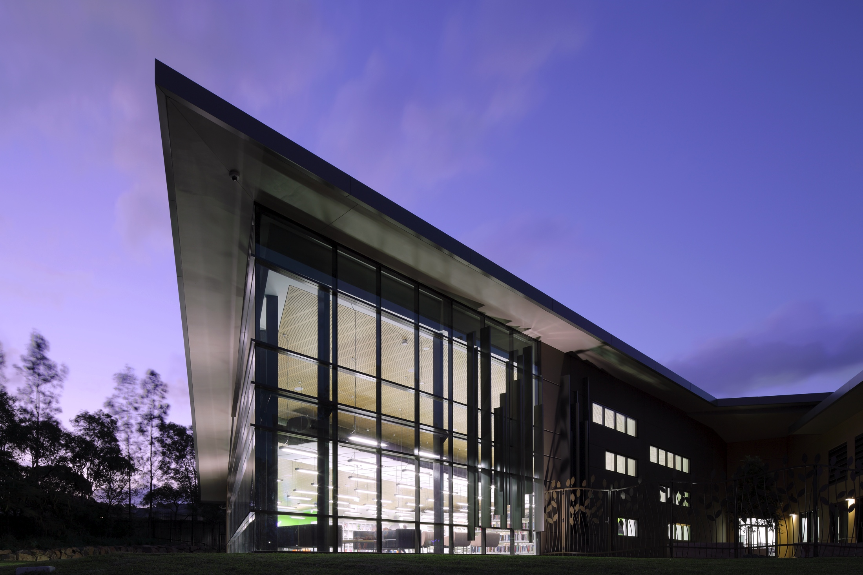
-

Slide 27
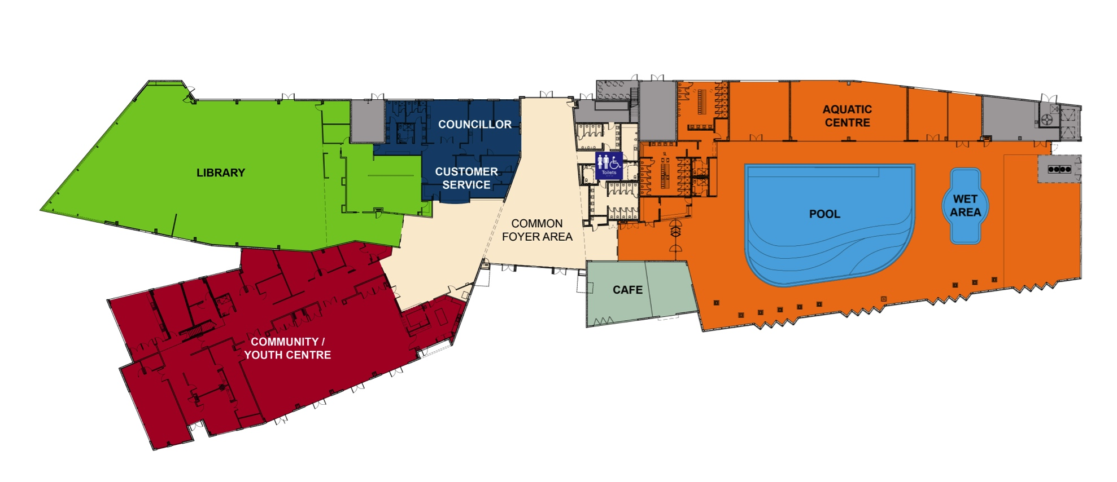
Notes:
Urban, suburbian and rural

Slide 28
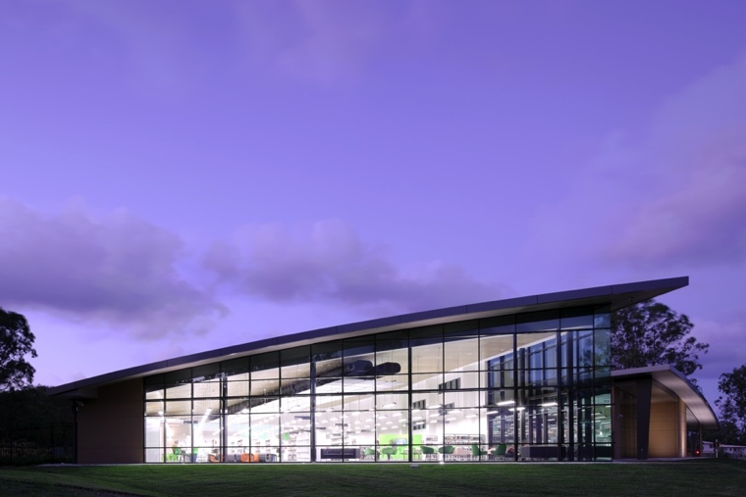
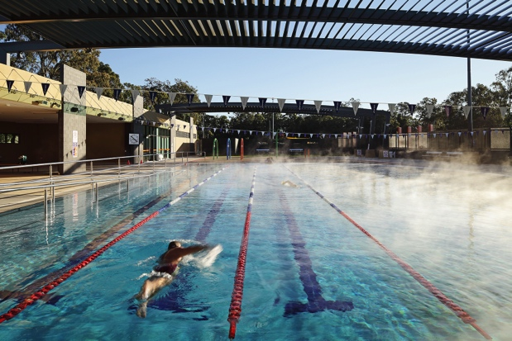
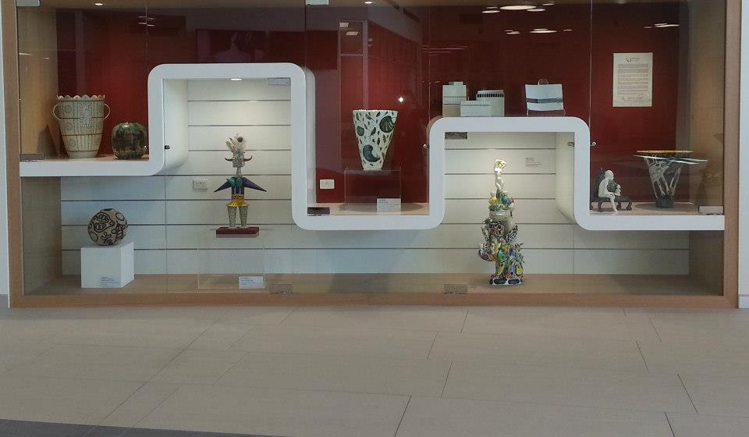
Notes:
Urban, suburbian and rural

Slide 29
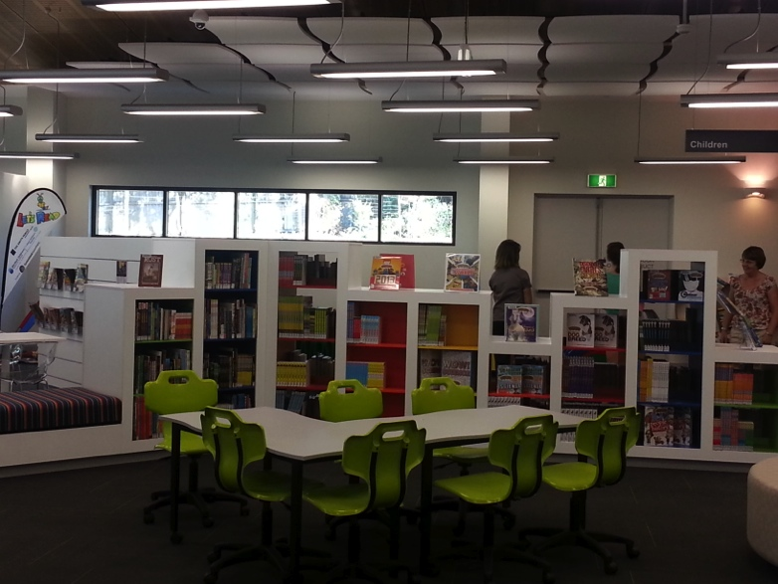
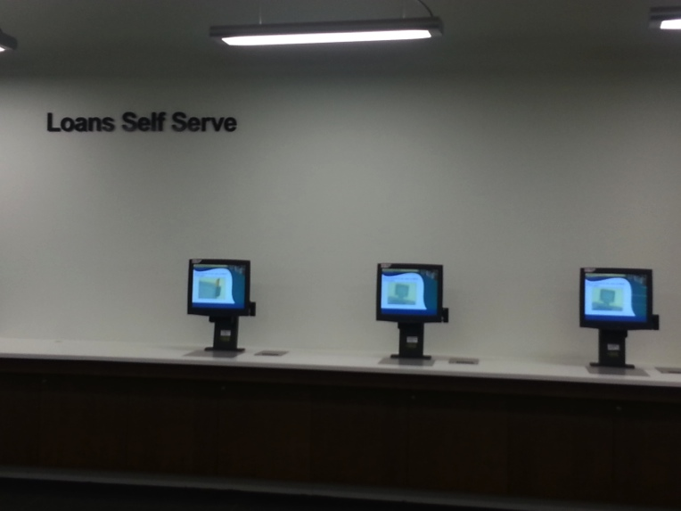
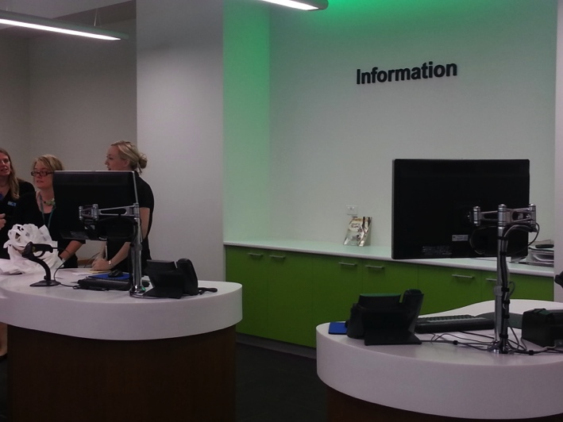
Photos: johnmillsphoto.com.au
Notes:
Urban, suburbian and rural

Slide 30
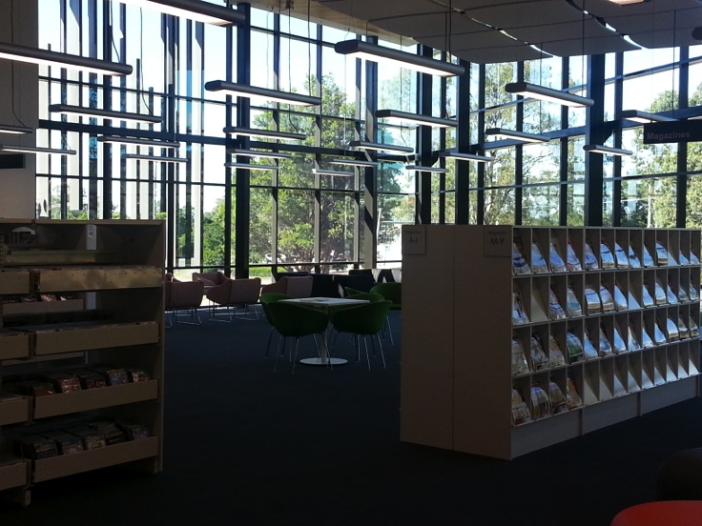
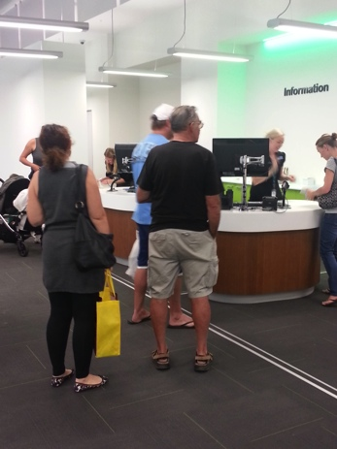
Notes:
Urban, suburbian and rural

Slide 32
Helensvale Library and Cultural Centre - a level one library

Slide 33
Helensvale Library and Cultural Centre
Opened 17 July 2013 42,000 visits in a month

Slide 34
Dear temporary Library,
We have known each other for more than a year, you have served us well, but after tonight I think it is time we stopped seeing each other.
It's not you, it's me.
I have met a newer, bigger and better Library and I think by mid-next month we will be seeing a lot of each other.
Take care with yourself (out in the mines).
Regards
W

Slide 36
Photos: johnmillsphoto.com.au

Slide 37
Public consultation
This Saturday afternoon the City is looking for your input on the draft Cultural Strategy.
If you would like to have a look around, take in some cool sounds and lounge around the forecourt come on down from 1.00pm to 4.00pm (and buy a sausage from the Rotary Trailer!)
PS Would greatly appreciate it if you could like & share this post amongst your own Facebook friends

Slide 38
Culture
Day 455 - So pleased to have the Gold Coast's very own Bree de Rome and The Lamplights (...just quietly how good are they) play for Helensvale this afternoon as a couple of hundred residents help out with our draft Cultural Strategy questionnaire.
This little fella was called Brandon - and he was captivated by the Lamplights. William Owen-Jones Division 2, Gold Coast
is on Facebook

Slide 39
Good to see that it didn't take long for the new rehearsal rooms and recording studios at the Helensvale Library and Cultural Centre to start getting some action
William Owen-Jones Division 2, Gold Coast
Facebook

Slide 40
Media Lab
A creative hub where customers can access technologies, usually only found in universities or state-of-the-art organisations. By making these resources publicly available, the Library Service is providing a creative incubator that connects people with innovative technologies.
Features:
Eight high end design capable computers, Digital cameras, Camcorders, Tripods, Headphones, Microphones, Scanning, tripods
3D and colour printing
Notes:
The Media Lab is a creative hub where customers can access technologies, usually only found in universities or state-of-the-art organisations. By making these resources publicly available, the Library Service is providing a creative incubator that connects people with innovative technologies. The Media Lab is available during library opening hours and bookings can be made at Helensvale Branch Library
3D Printer: The Gold Coast Libraries Media Lab uses a Project 260C 3D Printer. Unlike desktop models predominately in the market, this is a manufacturing grade colour 3D printer that produces conceptual models commonly used overseas in universities and design businesses. Three-dimensional objects are created by laying down successive layers of plaster that adhere to one another, creating a three-dimensional output. This 3D printer will be the first publicly available printer of its type in Queensland. Making this emerging technology publicly available will act as the springboard of new ideas. The ability to go from a two-dimensional model on a computer screen to a real-world object that can be handled is potentially transformative. Immediately accessible, 3D printing not only promotes but accelerates knowledge creation and innovation. 3D printing is available during library opening hours and bookings can be made at Helensvale Branch Library or by phoning 5581 1625. Printing charges apply for 3D printing.

Slide 41
Timing and Balance
Generic design brief
Readiness to respond
Opportunity
Evaluation

Slide 42
Notes:
Base document.

Slide 43
How it happens
Have your say! Community consultation

Slide 45
Questions?
-

Slide 48
-

