Slide 1
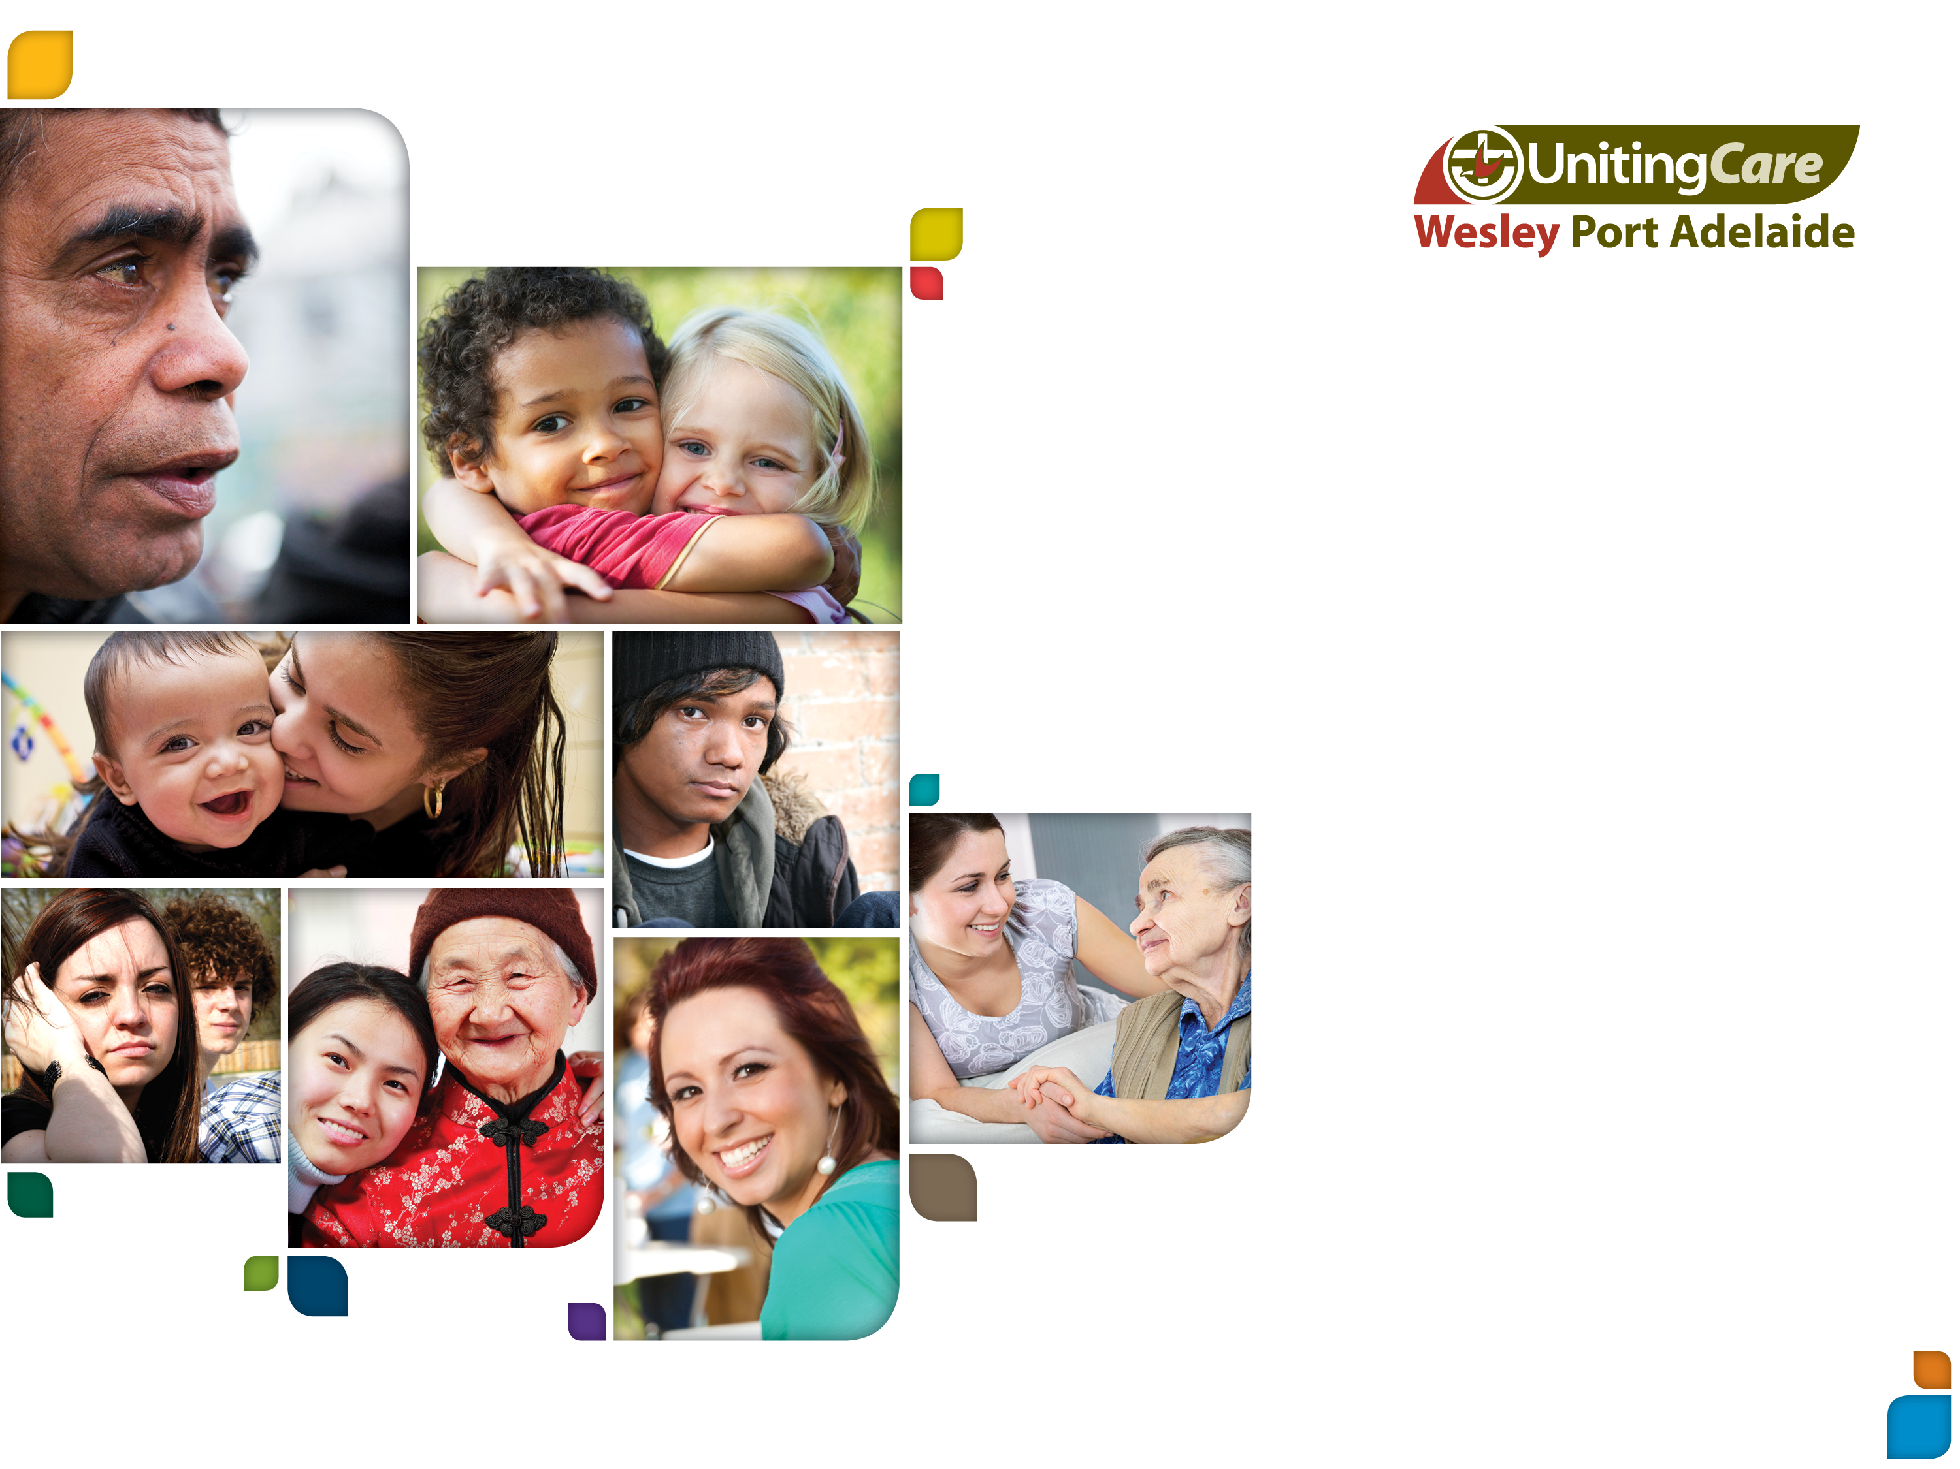
Public Libraries SA
Planning for success: from community engagement to civic participation
“Insert quote here”
(calibri regular italics 20pt)

Slide 2


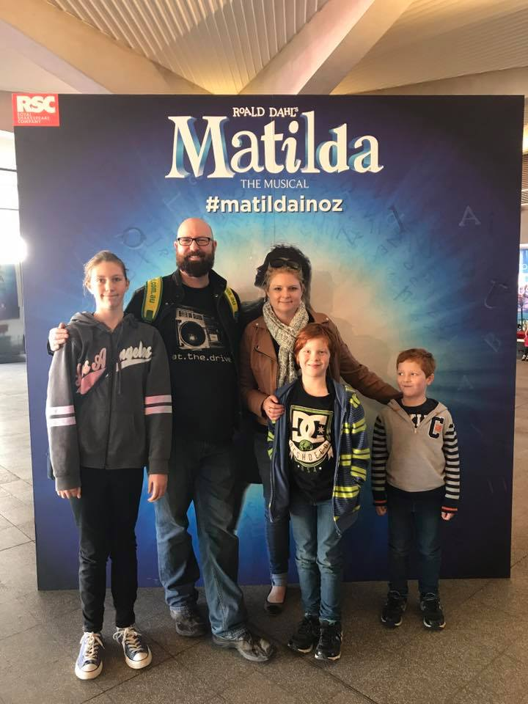

Who am I
Program Manager, Child, youth & family services

Slide 3
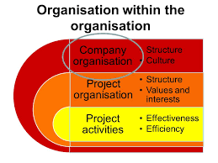
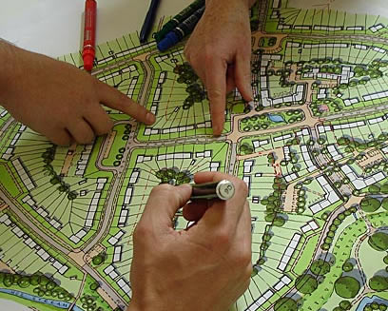
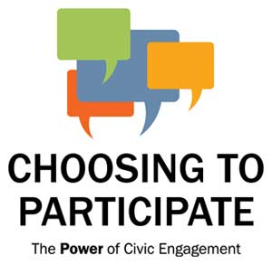

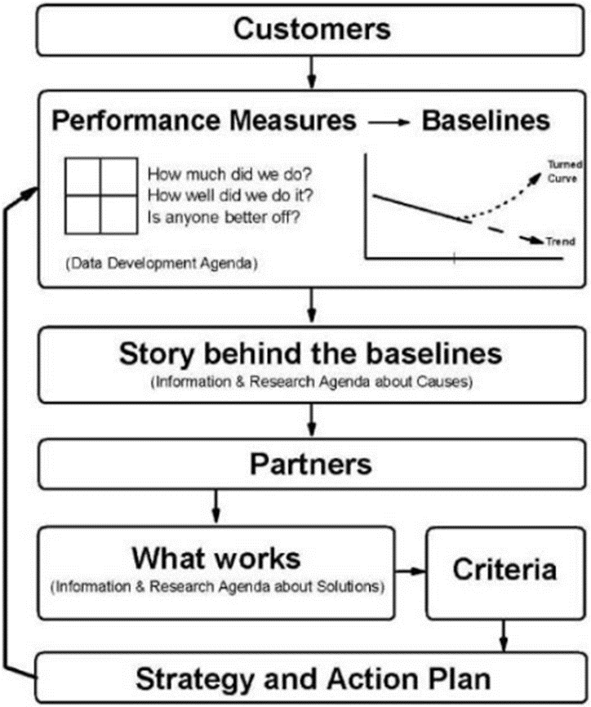
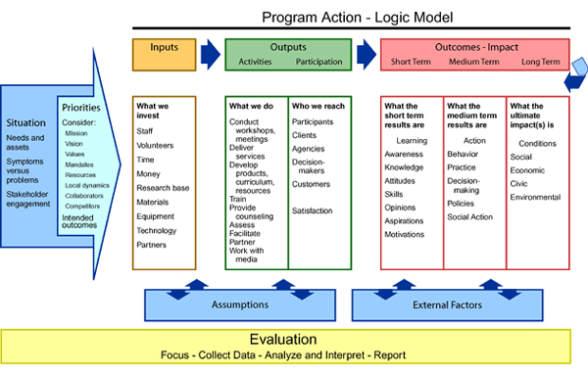
Planning for success

Slide 4
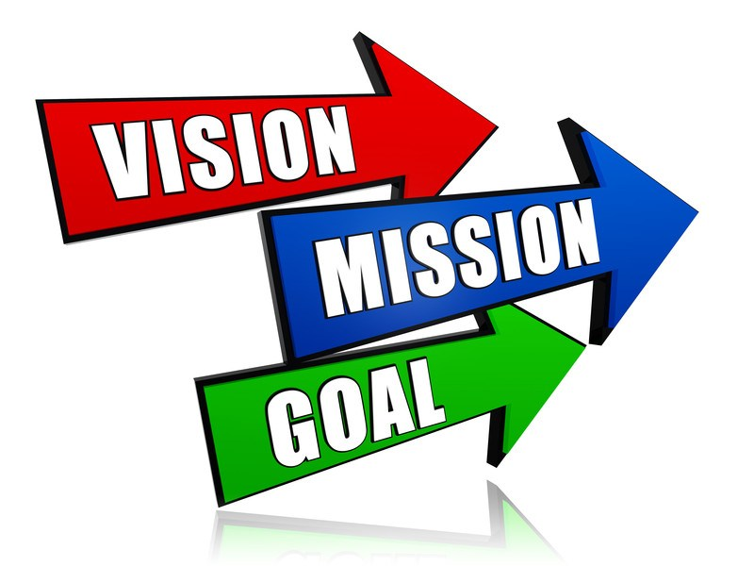
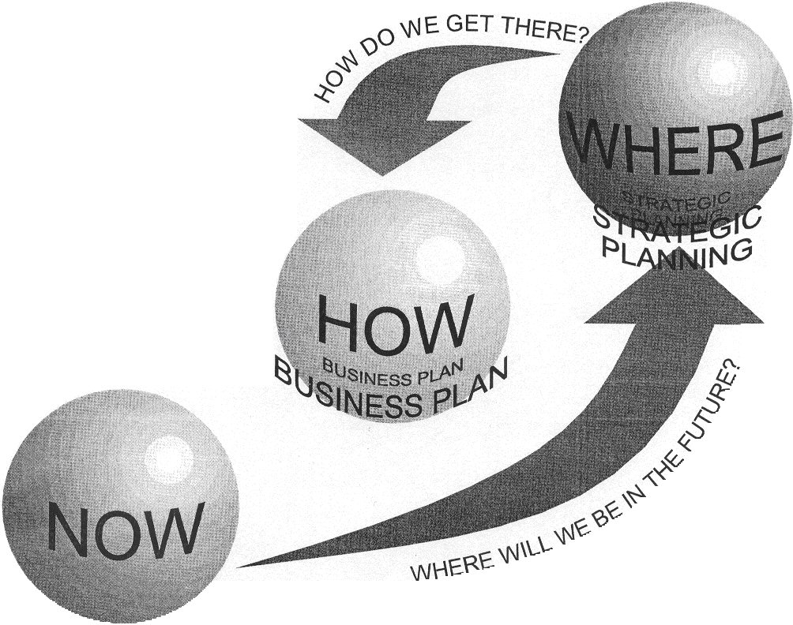
What is Strategic Planning

Slide 5

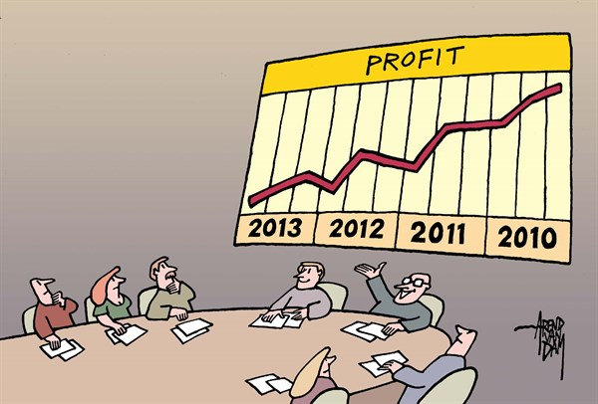

Strategic Plans
Vision
Mission
Values
Goals
Objectives
Indicators

Slide 6
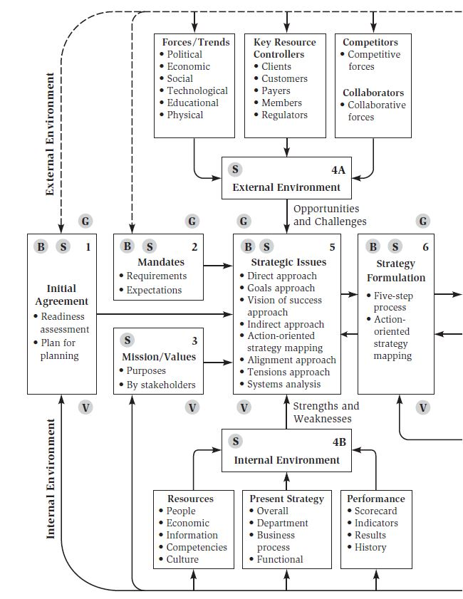
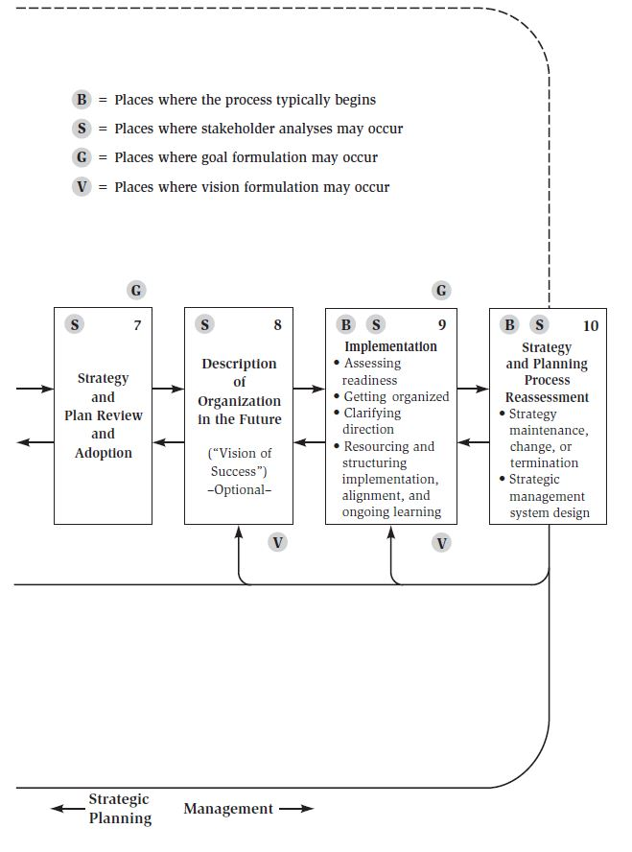
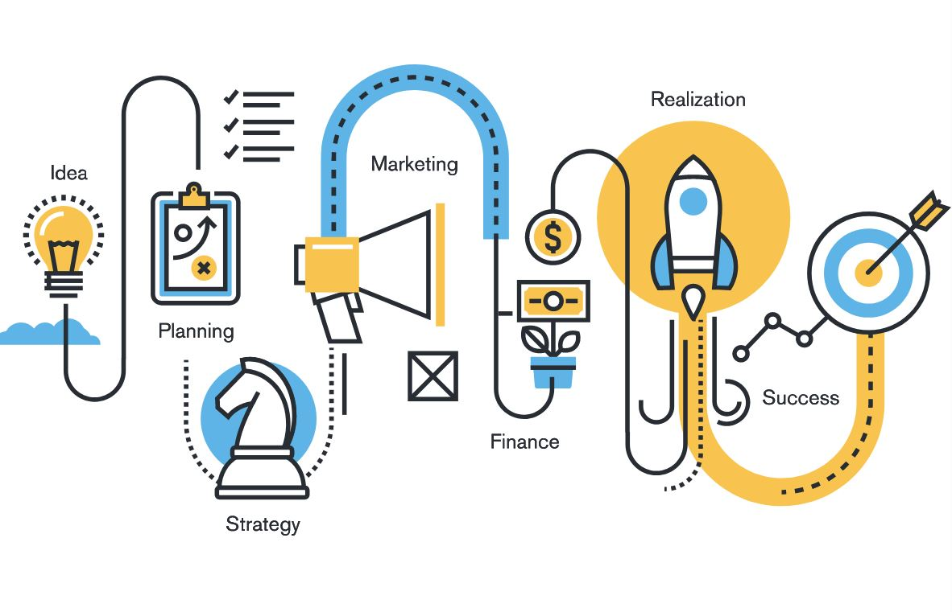
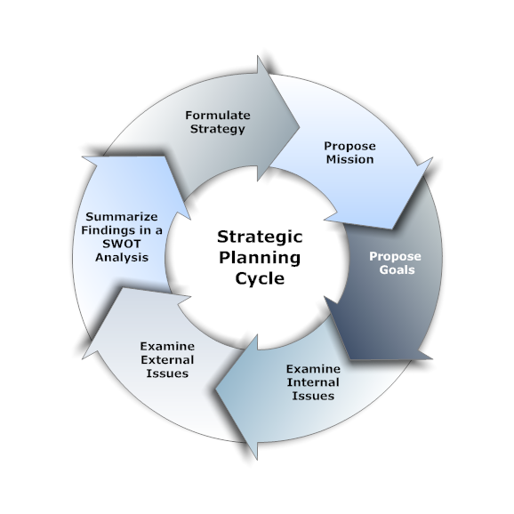
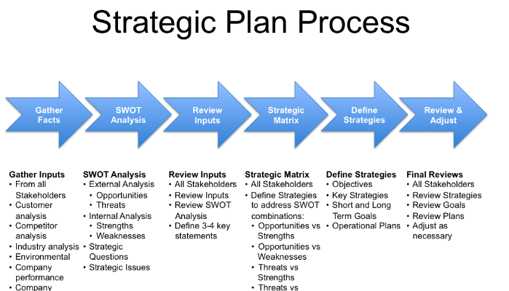
Strategic Planning - Methodologies

Slide 7

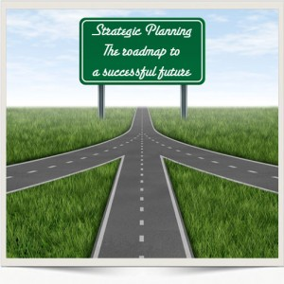

Marketing and Strategic Planning

Slide 8
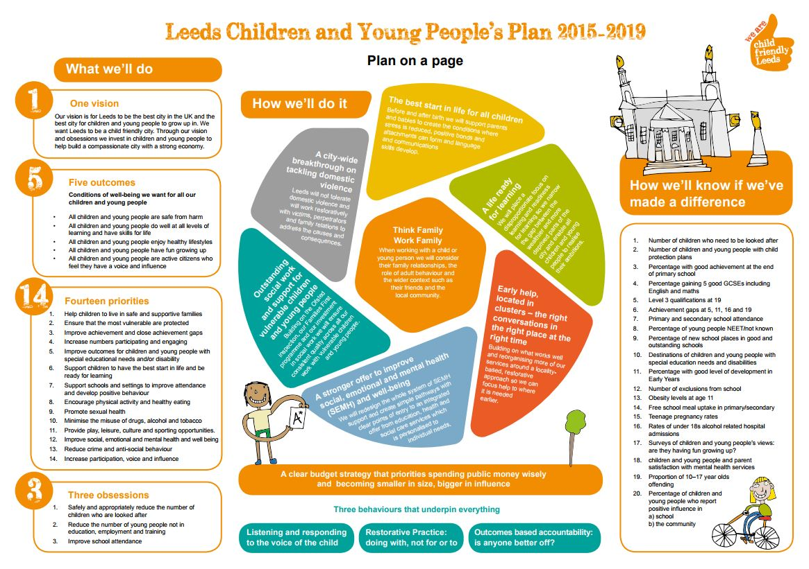

Slide 9

Communities for Children

Slide 10
Key components when planning
Data – know your community
Consult – engage and understand your community
Plan for ongoing engagement
Think of community engagement as a continuous improvement process

Slide 11

Community-informed mapping
AEDC
ABS
Community profile id.
Selected government data sets
Data
Consultations
Service Mapping
Education
Children
Parenting Services
Health
Service providers
Parents
Policy direction

Slide 12
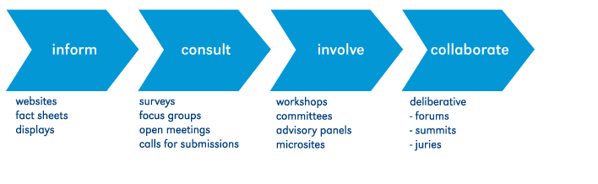
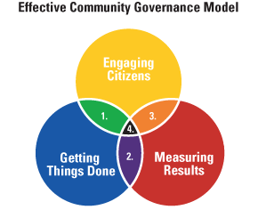
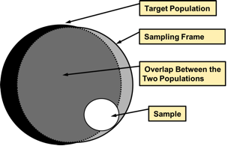
Community engagement/partnerships

Slide 13


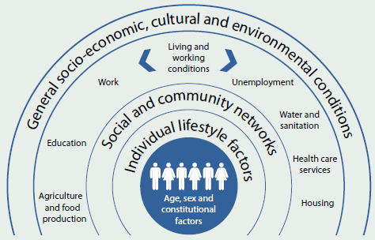

CfC Priority Areas

Slide 14
Pause for reflection
Do you have a discrete operational library plan, or does it fit within a broader service/deliver plan?
Is your library's plan reflective of the organisations broader Community Strategic Plan?
Does it reflect your communities needs?
Do the people accessing your libraries services reflect the demographics?

Slide 15
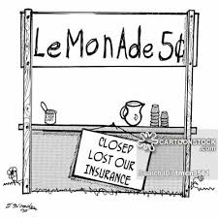


Defining community

Slide 16
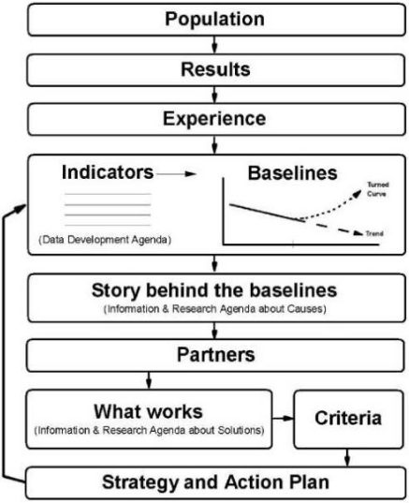
Community engagement to civic participation

Slide 17
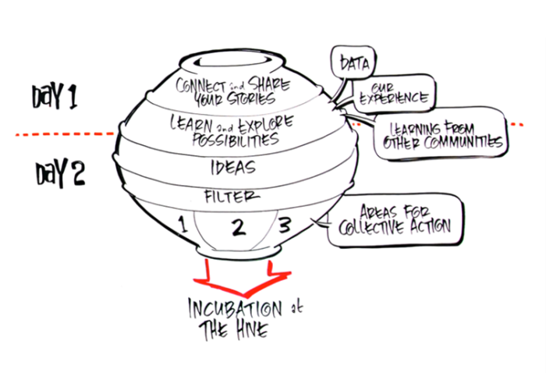
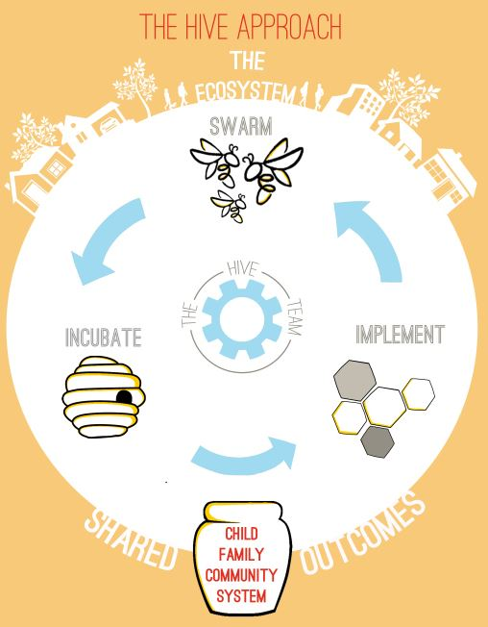
Examples of civic particiption

Slide 18
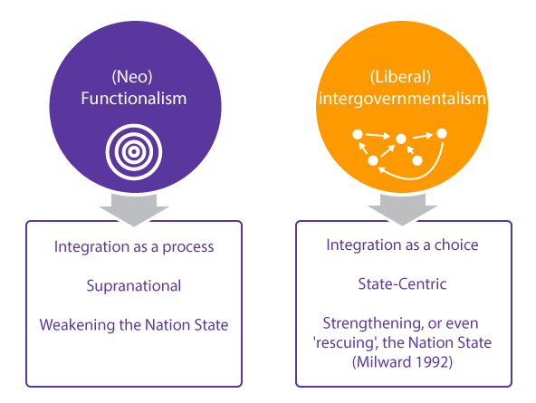
Things to remember

Slide 19
Paint the Parks and Gardens
UnitingSA + PAE Council = co-contribution for start-up
Shared contribution for discrete project.

Slide 20
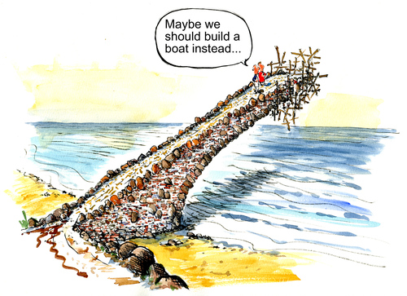
Program Planning

Slide 21
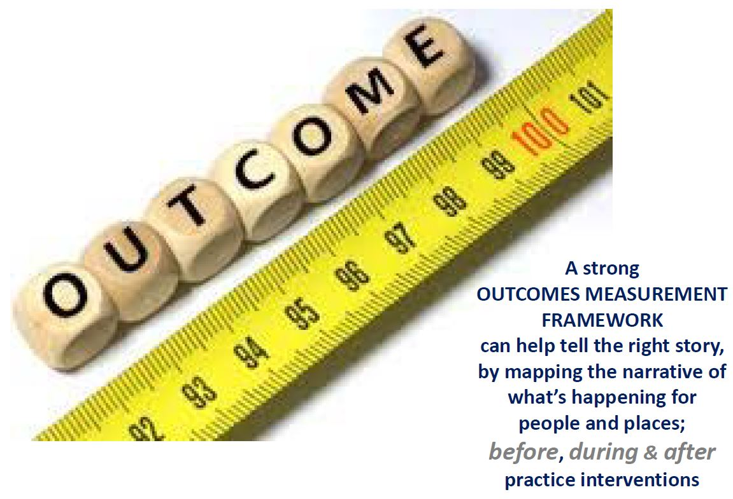
Telling your programs story…

Slide 22

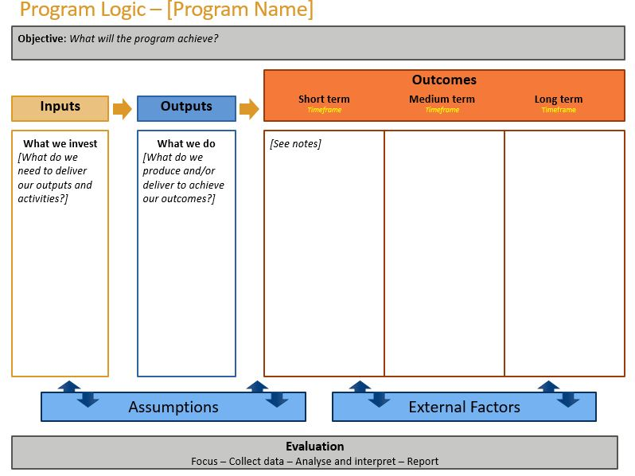
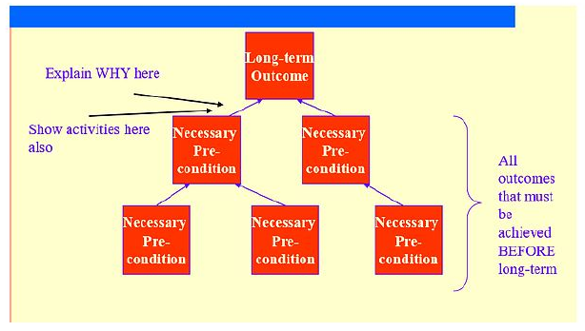
Different Types of Outcomes Frameworks
Theory of Change (ToC)

Slide 23
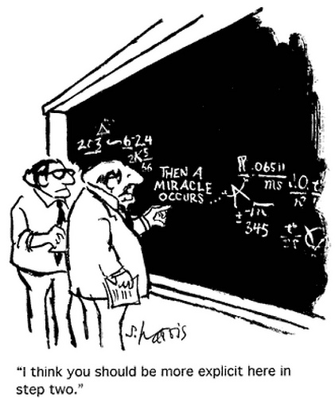
Program Logic
Reading from left to right, a logic model portrays a series of If-then relationships.

Slide 24
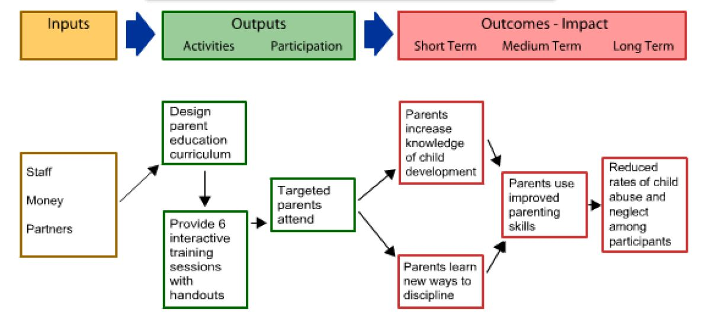
Program Logic: example one

Slide 25
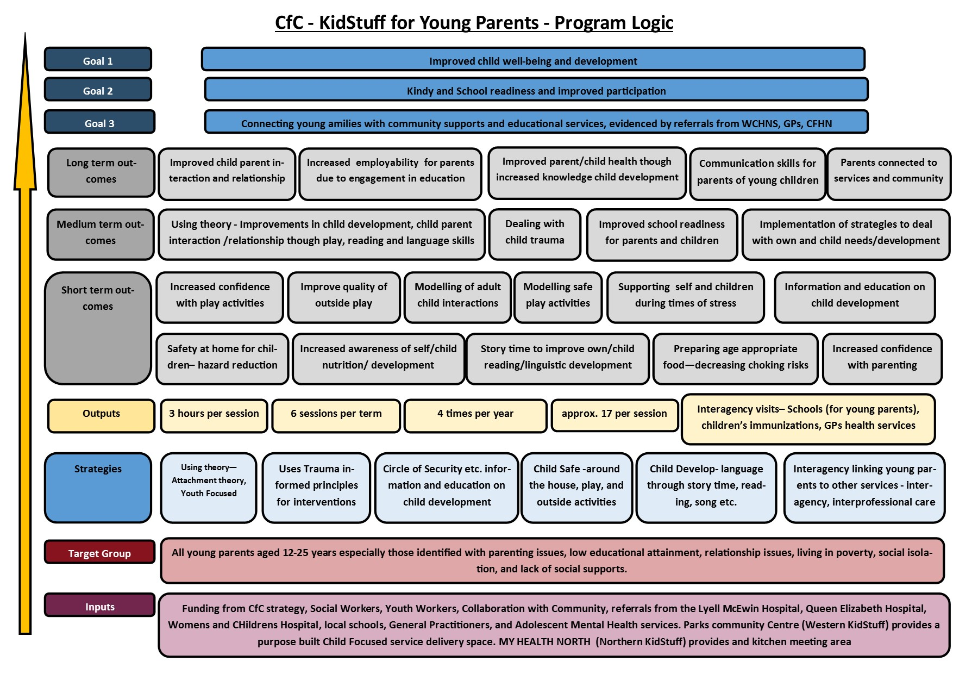
Program Logic: example two

Slide 26
Take home messages
Align your work with the organisations strategic plan;
What is the data story, what is the story behind the data;
Community engagement is an on-going process – what information do you already have about your community;
Are people your engaging with representative of your local community;
There are LOTS of methods and frameworks for planning.

Slide 27

Contact us
58 Dale St, PortAdelaide
Phone: 0410 017 706
Email: cbradbrook@ucwpa.org.au
www.ucwpa.org.au

