Slide 1

PUBLIC LIBRARIES SA QUARTERLY MEETING
Hetzel Theatre
State Library
Monday 10th November 2014
Michael Hanify
Wavesound

Slide 2
Wavesound is on the Preferred Suppliers Panel for the following..

Slide 3






Wavesound continues to grow its list
Introducing new imprints Jammer, Lamplight, Avid and Nudged
In addition to our established Harper Collins, Quercus and Canongate authors, we are adding more high profile authors to our list and many others will follow shortly!
No more delay to Australian libraries, our titles will always be the latest in synch with the rest of the world
In 2015 Wavesound will be introducing an exclusive Australian authors list
All large print and audio titles in all formats are 100% exclusive to Wavesound for Australian libraries

Slide 5





CLIPPER: Representing award winners, shortlisted titles, and top bestsellers from popular genres.
LAMPLIGHT: Represents traditional genres such as Sagas and Mysteries and long established authors.
NUDGED: A World of fun spoken word stories by bestselling authors, just for children – aged 2-12.
AVID: A new imprint dedicated to genre fiction – specifically supernatural, horror, Sci-Fi & fantasy.
JAMMER: Popular adult titles with a contemporary twist.
JAMMER TEENS: Ideal for engaging teenagers.
VISION AUSTRALIA: Wavesound have a selection of former Louis Braille Australian titles available.

Slide 6
www.wavesound.com.au

Slide 7
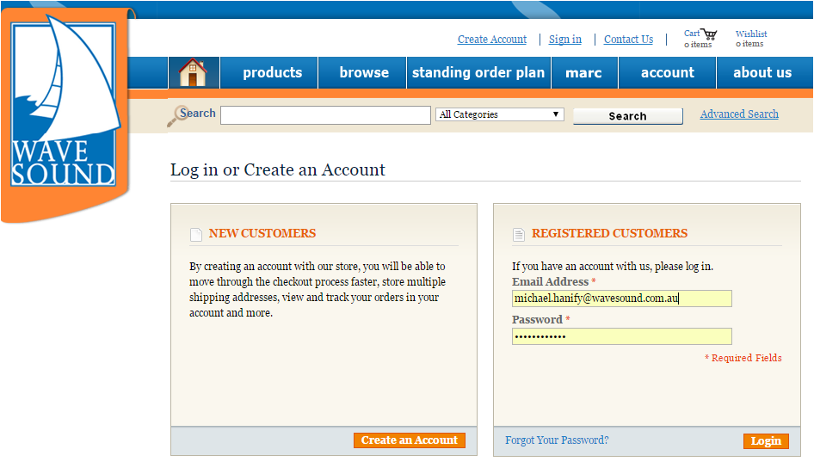

Slide 9


RBdigital Gateway Overview 2014
RBdigital Gateway provides customizable, secure electronic resources for library patrons and today’s modern libraries.
This single-platform dashboard gives librarians and patrons easy access to RBdigital’s exciting product offerings.
• Service for unique electronic resources in multiple product categories
• Simple, adaptable authentication and setup
• Training, promotional tools, and support for library staff and patrons
• Anywhere, anytime patron access
• Reports on new patrons and other usage statistics
• Single account setup for multiple resources*
• Special pricing for select bundled resources

Slide 10
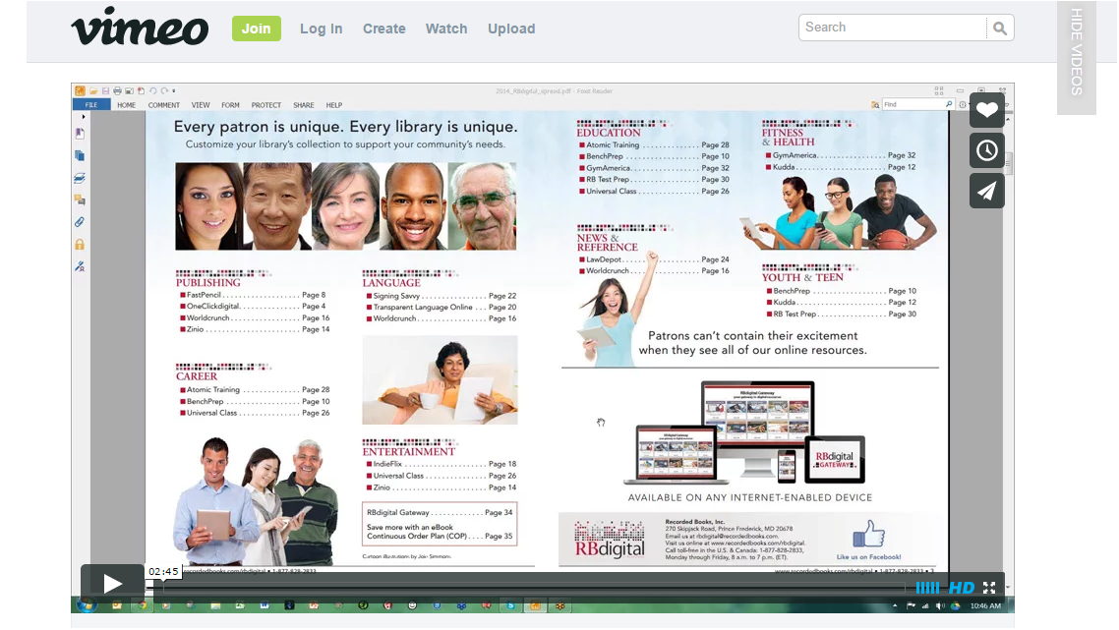
http://vimeo.com/94410811

Slide 11






One Click digital: One of the strongest collection of unabridged e-Audiobooks. Now includes eBooks.
ZINIO: Downloadable digital magazines. Available 24/7 easily viewed on any internet-enabled device.
INDIEFLIX: Award-winning independent films, shorts, documentaries from 1,000 film festivals worldwide.
TRANSPARENT LANGUAGE ONLINE: A language-learning program for libraries and their patrons.
UNIVERSAL: Provides your library members with online, self-paced, adult education courses across a wide variety of interesting and useful topics.
ATOMIC TRAINING: With Atomic Training, library staff and cardholders have access to online, on-demand video training tutorials on the most popular software topics.

Slide 12
Sirsidynix’ E-Resource Central
The new OneClickDigital upgraded e-Audio with eBooks platform is compatible with e-Resource Central
ZINIO is in pending phase and expected to be available 1st quarter 2015
RB Digital Gateway is in the pending phase with release expected 2nd quarter 2015
SIP2 and Web services as Authentication options
Expected to be available 1st quarter 2015

Slide 13

Thank you for allowing Wavesound to sponsor the
PUBLIC LIBRARIES SA QUARTERLY MEETING
We are pleased to be able to support the S.A. libraries

